Slide 1
Part 2.2: Symmetry and Point Groups

Slide 2
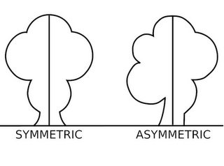
Outline
VSEPR
Define Symmetry
Symmetry elements
Symmetry operations
Point groups
Assigning point groups
Matrix math

Slide 3
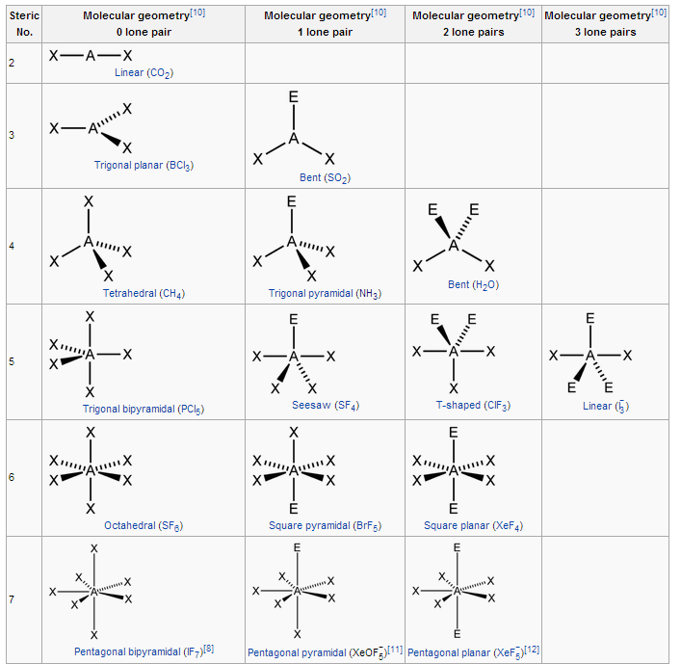
VSEPR
Valence shell electron pair repulsion (VSEPR) theory

Slide 4
Symmetry
You know intuitively if something is symmetric but we require a precise method to describe how an object or molecule is symmetric.
Definitions:
The quality of something that has two sides or halves that are the same or very close in size, shape, and position. (Webster)
When one shape becomes exactly like another if you flip, slide or turn it. (mathisfun.com)
The correspondence in size, form and arrangement of parts on opposites sides of a plane, line or point. (dictionary.com)
Symmetry Elements
Symmetry Operations

Slide 5
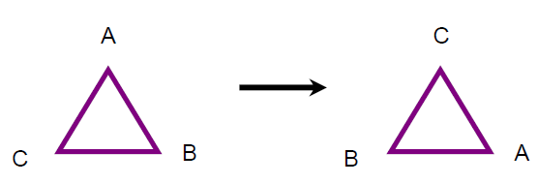
Symmetry
Symmetry Elements
a point, line or plane with respect to which the symmetry operation is performed
is a point of reference about which symmetry operations can take place
Symmetry Operations
a process that when complete leaves the object appearing as if nothing has changed (even through portions of the object may have moved).
Do Something!
If A, B and C are equivalent.

Slide 6
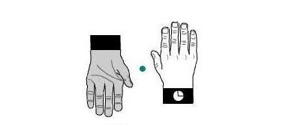
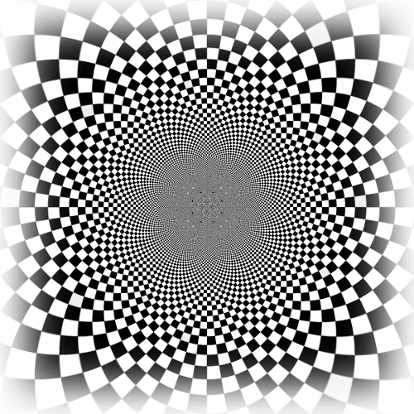
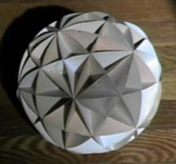
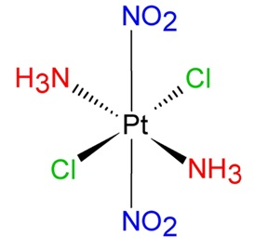
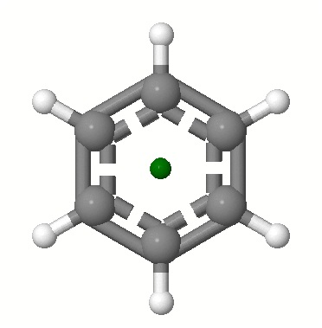
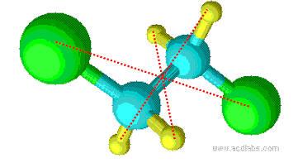
Symmetry Element: Inversion Center
For any part of an object there exists an identical part diametrically opposite this center an equal distance from it.
Each atom in the molecule is moved along a straight line through the inversion center to a point an equal distance from the inversion center.

Slide 7
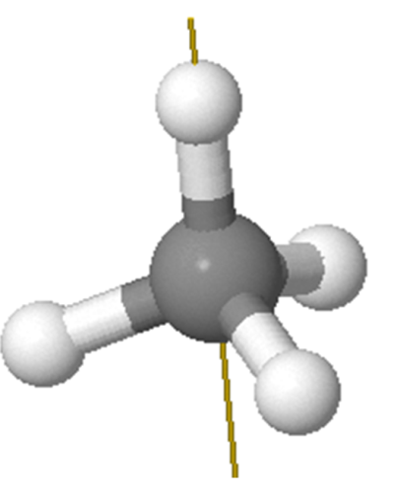
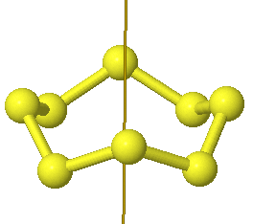
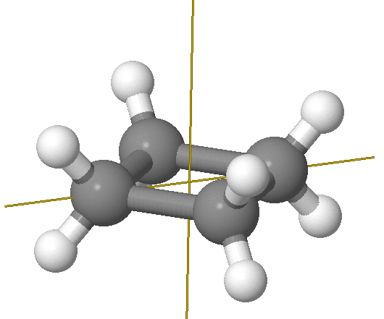
Symmetry Element: Axis
An axis around which a rotation by 360°/n results in an object indistinguishable from the original.
A molecule can have more than one symmetry axis; the one with the highest n is called the principal axis.

Slide 8
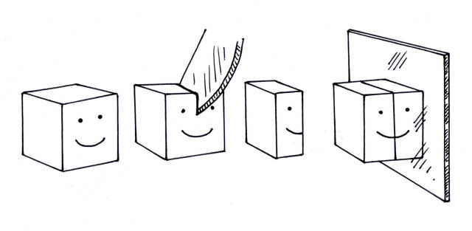
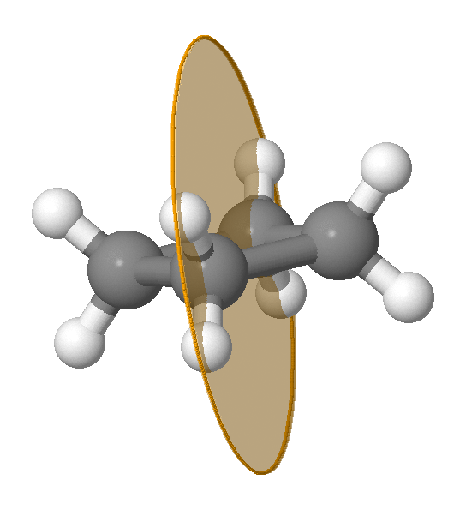
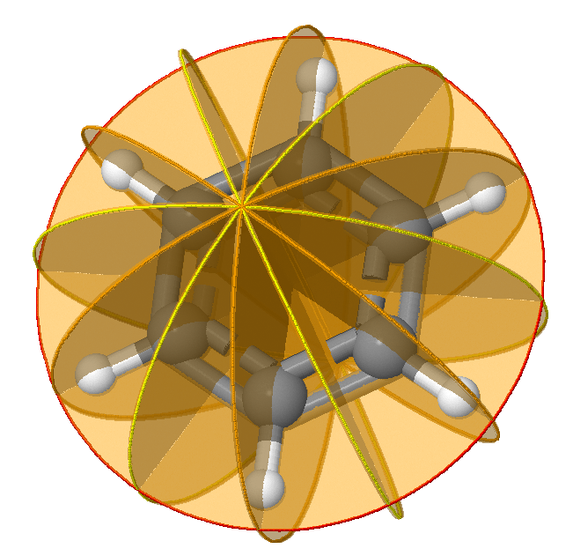
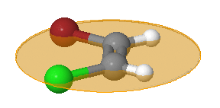
Symmetry Element: Plane
A plane of reflection through which an identical copy of the original is given.
A molecule can have more than one plane of symmetry.

Slide 9
Symmetry Elements
Point = Center of Symmetry
Line = Axis of Symmetry
= 0 dimension
Plane = Plane of Symmetry
= 1 dimension
Volume of symmetry?
= 2 dimensions

Slide 10
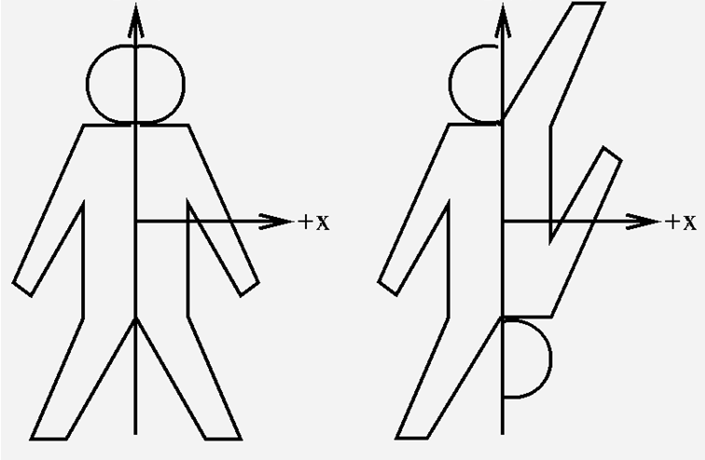
Elements and Operations
Symmetry elements
Axis
Mirror plane
Center of inversion
Symmetry Operations
Identity (E)
Proper Rotation (C_{n})
Reflection (σ)
Inversion (i)
Improper Rotation (S_{n})

Slide 11
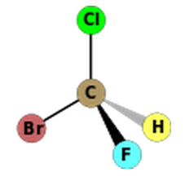
Identity (E)
Leaves the entire molecule unchanged.
All objects have identity.
Abbreviated E, from the German 'Einheit' meaning unity.
E
~ doing nothing!

Slide 12
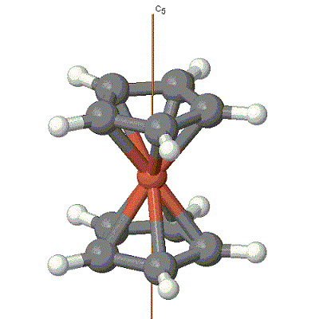
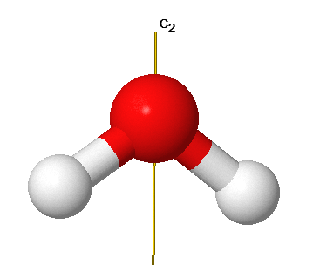
Proper Rotation (C_{n})
Rotation about an axis by 360°/n
C₂ rotates 180°, C6 rotates 60°.
Each rotation brings is indistinguishable from the original.
C₅
C₂
C_{n}^{m} : apply a C_{n} rotation m times

Slide 13
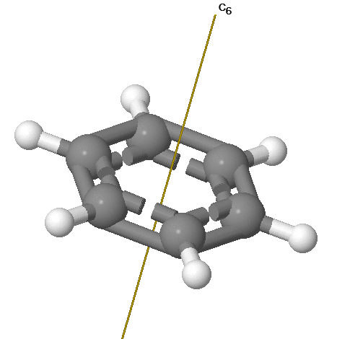
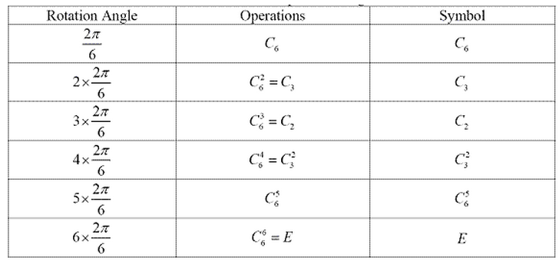
Rotations (C_{n})
C_{n}^{m} : apply a C_{n} rotation m times
360°/6 = 60°

Slide 14
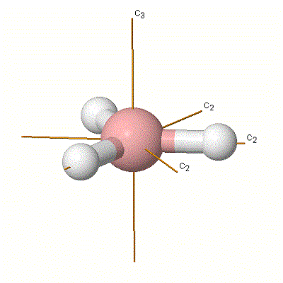
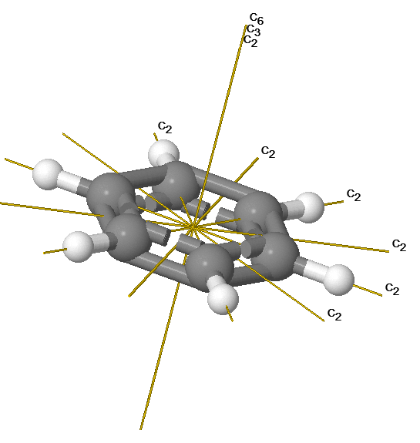
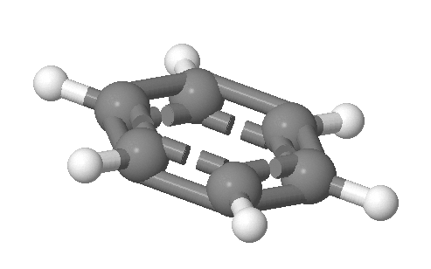
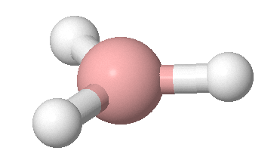
More than 1 C_{n}
BH₃
benzene
C₃
3 x ⊥C₂
C₆ , C₃ , C₂
6 x ⊥C₂
Highest n = principle axis (z-direction)

Slide 15
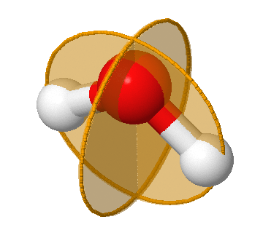
Reflection (σ)
Take each atom in the molecule and move it toward the reflection plane along a line perpendicular to that plane. Continue moving the atom through the plane to a point equidistant from the plane on the opposite side of the plane

Slide 16
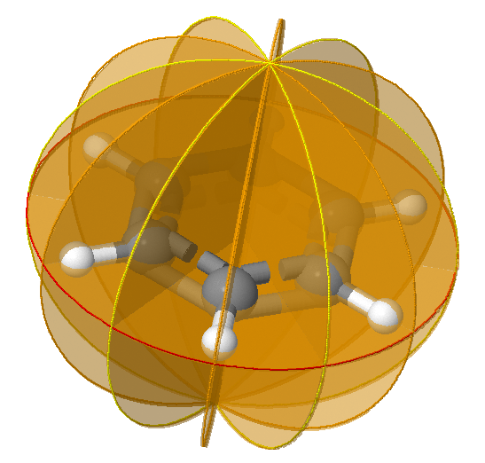
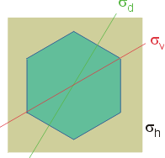
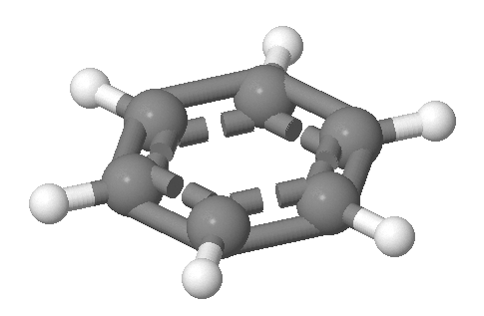
Reflection (σ)
Multiple Reflection Planes
benzene
σ_{v} = through atom vertical plane
σ_{d} = between atoms/bonds dihedral planes
σ_{h} = perpendicular to the primary rotation axis
3 x σ_{v}
3 x σ_{d}
1 x σ_{h}

Slide 17
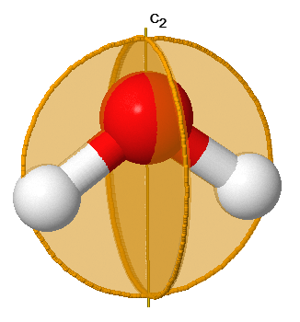
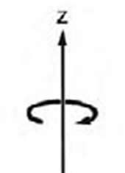
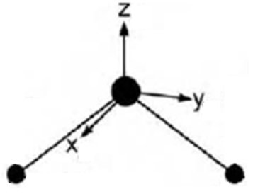
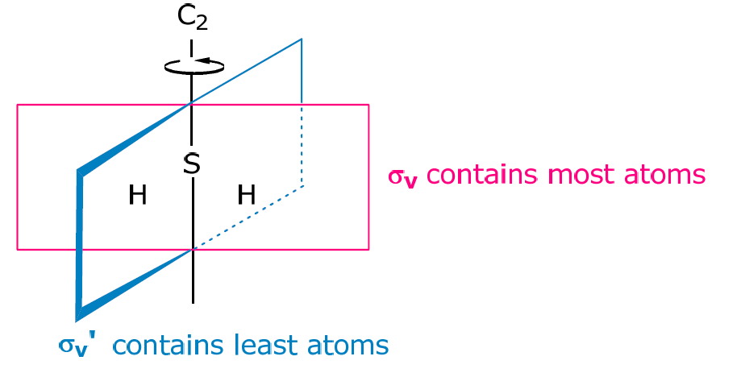
Reflection (σ)
Multiple Reflection Planes
C₂
σ_{v}’
_{or}
σ_{yz}
1
2
σ_{v}
_{or}
σ_{xz}

Slide 18
Inversion (i)
Each atom in the molecule is moved along a straight line through the inversion center to a point an equal distance from the inversion center.

Slide 19
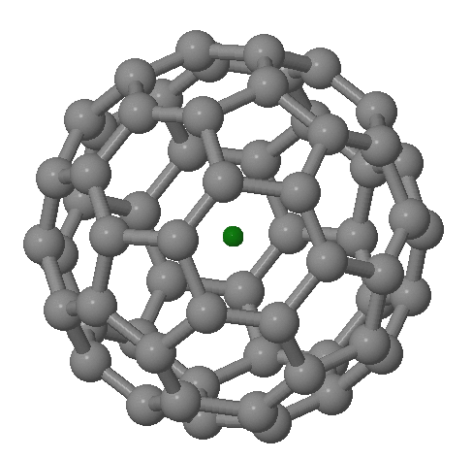
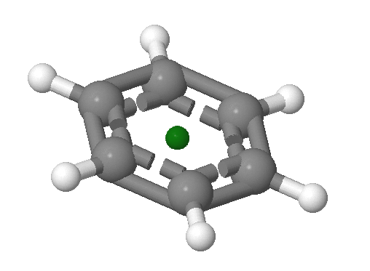
Inversion (i)
Does not require an atom at the center of inversion.
C60
Benzene

Slide 20
Improper Rotation (S_{n})
Rotation about an axis by 360°/n followed by reflection through the plane perpendicular to the rotation axis.
Labeled as an S_{n} axis.
S_{n}^{m} : apply a C_{n} rotation then reflection m times

Slide 21
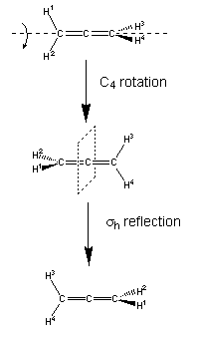
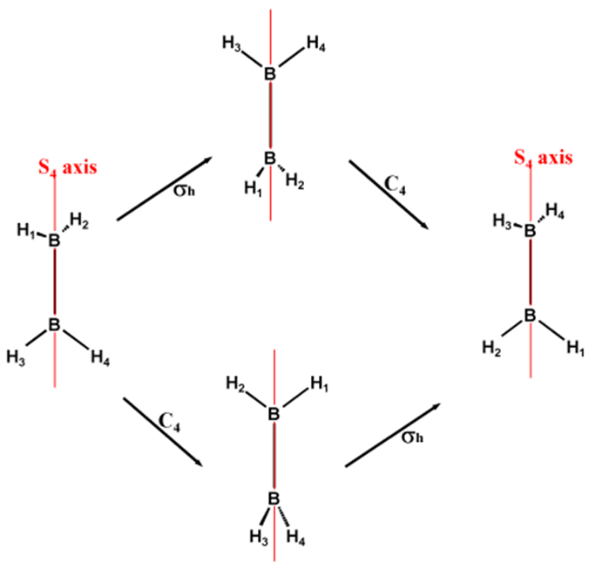
Improper Rotation (S_{n})
Allene
B₂H₄
S_{n}^{m} : apply a C_{n} rotation then reflection m times

Slide 22
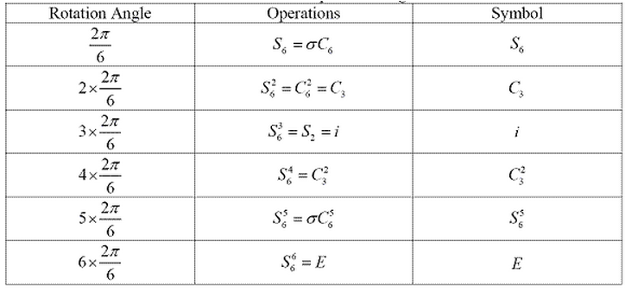
Improper Rotation (S_{n})
S_{n}^{m} : apply a C_{n} rotation then reflection m times
n = even

Slide 23
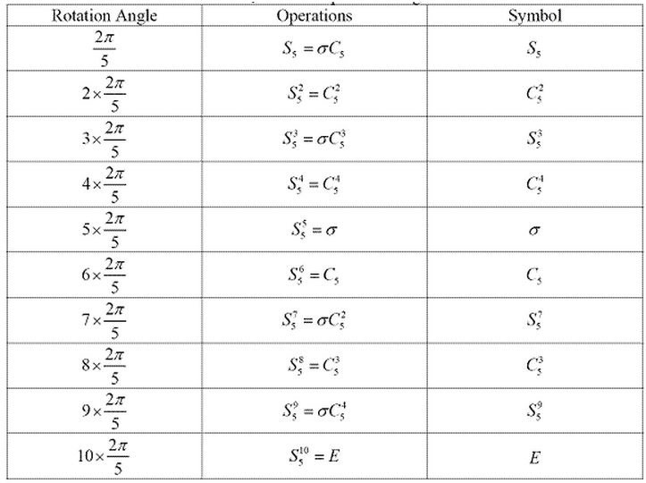
Improper Rotation (S_{n})
S_{n}^{m} : apply a C_{n} rotation then reflection m times
n = odd

Slide 24
Symmetry Operations
Identity (E)
Proper Rotation (C_{n})
Reflection (σ)
Inversion (i)
Improper Rotation (S_{n})

Slide 25
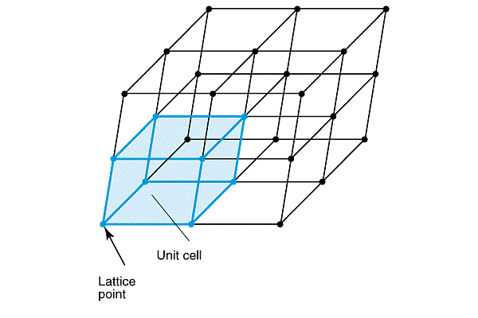
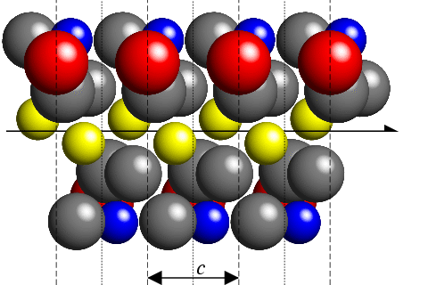
Side note: Crystals
Molecular Symmetry
Crystallographic Symmetry
Identity
Rotation
Reflection
Inversion
Center of Mass Unchanged
Additional Symmetry Operations

Slide 26
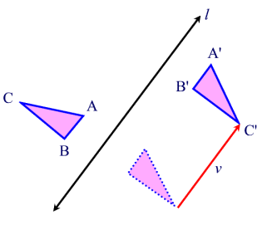
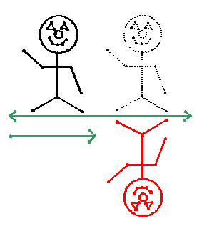
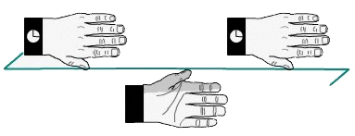
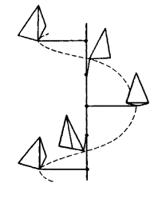
Crystallographic Symmetry Operations
Glide-reflection Symmetry
The combination of reflection and translation.
Screw Symmetry
The combination of rotation and translation.

Slide 27
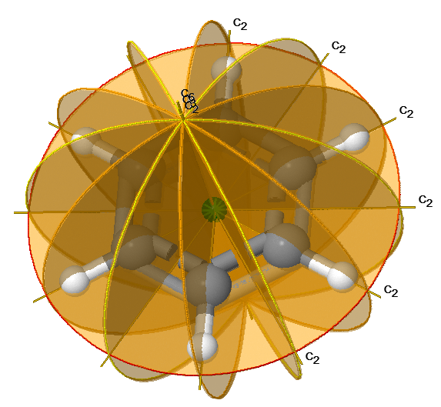
Groups of Symmetry Operations
Many molecules have 2 or more symmetry operations/elements.
Not all symmetry operations occur independently.
Molecules can be classified and grouped based on their symmetry.
Molecules with similar symmetry elements and operations belong to the same point group.
Called point group because symmetry operations are related to a fixed point in the molecule (the center of mass).

Slide 28
Point Groups
Infinite number of molecules, finite number of point groups.

Slide 29
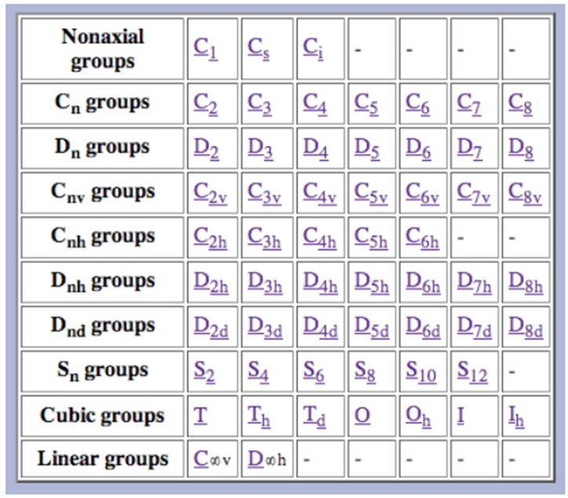
Types of Point Groups
Nonaxial (no rotation)
- C₁, C_{s}, C_{i}
Cyclic (rotational)
-C_{n}, C_{nv}, C_{nh}, S_{n}
Dihedral (⊥C₂)
- D_{n}, D_{nd}, D_{nh}
Polyhedral
- T, T_{h}, T_{d}, O, O_{h}, I, I_{h}
Linear
- C_{∞v}, D _{∞h}
http://symmetry.jacobs-university.de/

Slide 30
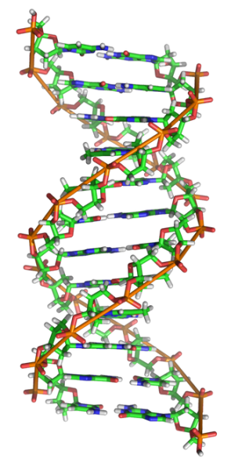
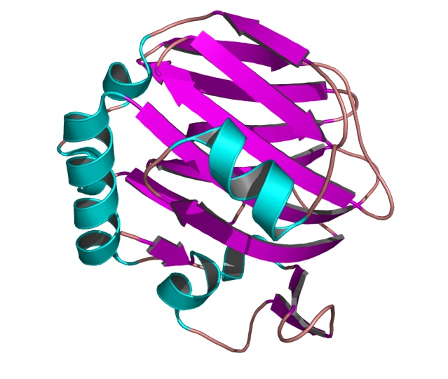
Nonaxial: C₁
There are no symmetry elements except E
Many molecules are C₁

Slide 31
Nonaxial: C_{s}
Symmetry elements: E and σ
Notes:
Newman projection

Slide 32
Nonaxial: C_{i}
Symmetry elements: E and i
Notes:
Newman projection

Slide 33
Cyclic: C_{n}
Symmetry elements: E and C_{n}
C₃
C₂
C₆
[6]-rotane

Slide 34
Cyclic: C_{nv}
Symmetry elements: E, σ_{v}/σ_{d}and C_{n}
gallium(η⁶-C₆Me₆)
C_{2v}
C_{6v}
C₂ principle axis
σ_{v} contains C₂ axis
σ_{d} contains C₂ axis
C₆ principle axis
3 x σ_{v} contains C₆ axis
3 x σ_{d} contains C₆ axis

Slide 35
Cyclic: C_{nh}
Symmetry elements: E, σ_{h}, S_{n} and C_{n}
hexakis(Me₂N)benzene
C_{3h}
C_{6h}
C₃ principle axis
σ_{h} ⊥ to C₃ axis
S₃ axis
C₆ principle axis
σ_{h} ⊥ to C₆ axis
S₆ axis

Slide 36
Cyclic: C_{nh}
Symmetry elements: E, σ_{h}, S_{n} and C_{n}

Slide 37
Cyclic: S_{n}
Symmetry elements: E and S_{n}
tetrabromopentane
18-crown-6
S₄
S₆
S₄, C₂ principle axis
S₆, C₃ principle axis
Only S₄, S₆, S₈, etc.

Slide 38
Dihedral Point Groups
C₂ perpendicular to C_{n}
C_{n}
C_{n}
C_{n}
C₂
C₂
C₂
σ_{h}
σ_{d}
D_{n}
D_{nd}
D_{nh}

Slide 39
Dihedral: D_{n}
Symmetry elements: E, C_{n} and ⊥C₂
D₂
D₃
(SCH₂CH₂)₃
D₃

Slide 40
Dihedral: D_{n}
Symmetry elements: E, C_{n} and ⊥C₂
Ni(en)₃
en = H₂NCH₂CH₂NH₂
1 x C₃
3 x ⊥C₂

Slide 41
Dihedral: D_{nd}
Symmetry elements: E, C_{n}, ⊥C₂ and σ_{d}
Allene
D_{2d}

Slide 42
Dihedra: D_{nd}
Symmetry elements: E, C_{n}, ⊥C₂ and σ_{d}
D_{2d}
View down the C₅ axis
Staggard Sandwich complexes (D_{5d})

Slide 43
Dihedra: D_{nh}
Symmetry elements: E, C_{n}, ⊥C₂ and σ_{h}
Benzene
D_{6h}

Slide 44
Dihedra: D_{nh}
Symmetry elements: E, C_{n}, ⊥C₂ and σ_{h}
D_{3h}
D_{2h}
D_{6h}
D_{5h}
D_{4h}

Slide 45
Dihedra: D_{nh}
Symmetry elements: E, C_{n}, ⊥C₂ and σ_{h}
Y
X
X
X
OsCl₂(CO)₄
X
Y
trans-MY₂X₄
PtCl₄

Slide 46
Dihedral Point Groups
Ferrocene (Fc)
D₅
D_{5d}
D_{5h}

Slide 47
Polyhedral Point Groups
More than two high-order axes
Fire
Earth
Air
Water
Sometimes referred to as the Platonic solids.

Slide 48
Polyhedral Point Groups
More than two high-order axes
Point Groups
Tetrahedral
- T, T_{h}, T_{d}
Octahedral
- O, O_{h}
Icosahedral
- I, I_{h}
I, O and T rarely found
No mirror planes!

Slide 49
Polyhedral: Tetrahedron
Point Groups
No σ
Has σ_{d}
Has σ_{h}

Slide 50
Polyhedral: T
Only Rotational Symmetry!
No σ
[Ca(THF)₆]²⁺
Very rare!

Slide 51
Polyhedral: T_{d}
Rotational + σ_{d}
Most common tetrahedral point group

Slide 52
Polyhedral: T_{h}
Rotational + σ_{h}
Has σ_{h}

Slide 53
Polyhedral: Octahedron
Point Groups
No σ
Has σ_{h}

Slide 54
Polyhedral: Octahedron
Very rare!
No σ
V₆P₈O₂₄ -core
Dodeka(ethylene)octamine

Slide 55
Polyhedral: Octahedron

Slide 56
Polyhedral: Octahedron

Slide 57
Polyhedral: Icosahedral
Point Groups
I
E, 15C₅, 12C₅², 20C₃, 15C₂
No σ
I couldn’t find a molecule
snub dodecahedron
E, 15C₅, 12C₅², 20C₃, 15C₂, i, 12S₁₀, 12S₁₀³, 20S₆, 15σ
I_{h}
Has σ_{h}
Icosahedron

Slide 58
Polyhedral: Icosahedral
E, 15C₅, 12C₅², 20C₃, 15C₂, i, 12S₁₀, 12S₁₀³, 20S₆, 15σ
I_{h}
Has σ_{h}
Icosahedron
B₁₂H₁₂

Slide 59
Polyhedral Point Groups
More than two high-order axes
Point Groups
Tetrahedral
- T, T_{h}, T_{d}
Octahedral
- O, O_{h}
Icosahedral
- I, I_{h}
I, O and T rarely found
No mirror planes!

Slide 60
High Symmetry
B_{x}H_{x}

Slide 61
Linear Point Groups
Point Groups
E, C∞, ∞σ_{v}
C_{∞v}
HCl, CO, NC
NCS, HCN, HCCH
No σ
E, C∞, ∞σ_{v}, ∞C₂, I
D_{∞h}
H₂, N₂, O₂, F₂, Cl₂
CO₂, BeH₂, N₃
Has σ_{h}

Slide 62
Types of Point Groups
Nonaxial (no rotation)
- C₁, C_{s}, C_{i}
Cyclic (rotational)
-C_{n}, C_{nv}, C_{nh}, S_{n}
Dihedral (⊥C₂)
- D_{n}, D_{nd}, D_{nh}
Polyhedral
- T, T_{h}, T_{d}, O, O_{h}, I, I_{h}
Linear
- C_{∞v}, D _{∞h}
http://symmetry.jacobs-university.de/

Slide 63
Assigning point groups
Memorize
C_{s}: E and S
O_{h}: E, 3S₄, 3C₄, 6C₂, 4S₆, 4C₃, 3σ_{h}, 6σ_{d}, i
Flow chart

Slide 67
CO₂

Slide 68
∞
∞

Slide 70
Cotton’s “five-step” Procedure

Slide 71
General Assignments
For MX_{n}
M is a central atom
X is a ligand
VSEPR Geometry | Point group
Linear | D∞h
Bent or V-shape | C_{2v}
Trigonal planar | D_{3h}
Trigonal pyramidal | C_{3v}
Trigonal bipyramidal | D_{5h}
Tetrahedral | T_{d}
Sawhorse or see-saw | C_{2v}
T-shape | C_{2v}
Octahedral | Oh
Square pyramidal | C_{4v}
Square planar | D_{4h}
Pentagonal bipyramidal | D_{5h}

Slide 72
Webpage
http://symmetry.otterbein.edu/gallery/index.html

Slide 73
Pitfalls in Assigning Symmetry
2-D vs 3-D
Global vs. Local
Dynamic Molecules

Slide 74
2-D vs 3-D Molecules
D_{3h}
C₃

Slide 75
Global vs. Local Symmetry
hν
+
2 + 2 cycloaddition
vs.
C_{2v}
C_{s}

Slide 76
Global vs. Local Symmetry
D₃
O_{h}
A₁ = z²
E = x²-y², xy, xz, yz
E_{g} = z², x²-y²
T_{2g} = xy, xz, yz

Slide 77
Global vs. Local Symmetry
hemoglobin
heme
porphyrin
C₂
C_{s}
D_{4h}

Slide 78
Global vs. Local Symmetry
Crystals
Quasicrystals
No translation
Dan Shechtman 2011 Nobel Prize in Chemistry

Slide 79
Dynamic Molecules
Amine Inversion
10^{^10} per second
Changes in:
Symmetry
Dipole moment
Chirality
Vibrational motion
Symmetry Through the Eyes of a Chemist

Slide 80
Dynamic Molecules

Slide 81
Assign the point group
CO₂
OCS
NH₃
SF₆
CCl₄
H₂C=CH₂
H₂C=CF₂

Slide 82
Stereographic Projections
two-fold rotational axis
three-fold rotational axis
Solid line = σ_{v}
Dashed line = σ_{d}
Objection Position
• = in plane
x = below plane
o = above plane
Dashed circle = no σ_{d}
Solid circle = σ_{h}

Slide 83
Stereographic Projections
S₄ axis
S₄ and C₂
C₃, 3C₂, S₆, and 3σ_{d}

Slide 84
Stereographic Projections
What about I_{h}?

Slide 85
Stereographic Projections
6C₅, 10C₃, 15C₂, 15σ

Slide 86
What Point Group?
D_{4h}
C_{6h}
D₃

Slide 87
Symmetry Operation Math
σ_{xz}
C₅
O (x_{o}, y_{o}, z_{o})
O (x_{o}, -y_{o}, z_{o})
C1 (x_{c1}, y_{c1}, z_{c1})
H1 (x_{h1}, y_{h1}, z_{h1})
H1 (x_{h1}, -y_{h1}, z_{h1})
.
.
H2 (x_{h2}, y_{h2}, z_{h2})
H2 (x_{h2}, -y_{h2}, z_{h2})
.
C60 (x_{c60}, y_{c60}, z_{c60})
Easy Alternative: Represent symmetry operations with matrices.
Object
Object
after σ_{xz}
Matrix for σ_{xz}
•
=

Slide 88
Matrix Math Outline
Matrices
Trace/character
Matrix algebra
Inverse Matrix
Block Diagonal
Direct Sum
Direct Product
Symmetry operation matrix

Slide 89
Matrices
A matrix is a rectangular array of numbers, or symbols for numbers. These elements are put between square brackets.
Generally a matrix has m rows and n columns:
n columns
Square matrix,
m=n
m Rows

Slide 90
Trace/Character
The character of a matrix is the sum of its diagonal elements.
square matrix
Method to simplify a matrix.

Slide 91
Special Matricies
Column Matrix: used to represent a point or a vector.
Unit Matrix/Identity: All elements in the diagonal are 1 and the rest are zero.
The Identity Matrix (E)

Slide 92
Matrix Algebra
For two matricies with equal dimensions:
Addition:
Subtraction:
Multiply by a constant:

Slide 93
Matrix Multiplication
If two matrices are to be multiplied together they must be conformable; i.e., the number of columns in the first (left) matrix must be the same as the number of rows in the second (right) matrix.
To get the first member of the first row, all elements of the first row of the first matrix are multiplied by the corresponding elements of the first column of the second matrix and the results are added. To get the second member of the first row, all elements of the first row of the first matrix are multiplied by the corresponding members of the second column of the second matrix and the results are added, and so on.

Slide 94
Matrix Multiplication
If two matrices are to be multiplied together they must be conformable; i.e., the number of columns in the first (left) matrix must be the same as the number of rows in the second (right) matrix.
To get the first member of the first row, all elements of the first row of the first matrix are multiplied by the corresponding elements of the first column of the second matrix and the results are added. To get the second member of the first row, all elements of the first row of the first matrix are multiplied by the corresponding members of the second column of the second matrix and the results are added, and so on.

Slide 95
Matrix Multiplication

Slide 96
Matrix Multiplication
Non-square matrix-
The number of columns in the first (left) matrix must be the same as the number of rows in the second (right) matrix.
2 columns
2 Rows
columns of a
= rows of b
3x2 times 2x3 = 3x3

Slide 97
Matrix Multiplication
Non-square matrix-
The number of columns in the first (left) matrix must be the same as the number of rows in the second (right) matrix.
2 columns
2 Rows
columns of a
= rows of b
3x2 times 2x3 = 3x3

Slide 98
Matrix Multiplication: Vectors
Identity Matrix (E)
vector
vector

Slide 99
Inverse Matrices
If two square matrices A and B multiply together,
and A B = E
then B is said to the inverse of A (written A⁻¹). B is also the inverse of A.
A
B
E
aka A⁻¹
Rules that govern groups:
4) For every element in the group there exists an inverse.

Slide 100
Block-diagonal Matrix
A block-diagonal matrix has nonzero values only in square blocks along the diagonal from the top left to the bottom right

Slide 101
Block Diagonal Matrix
Full Matrix Multiplication
Block Multiplication
Row 1
and so on…
Important in reducing matrix representations.

Slide 102
Direct Sum
A direct sum of two matrices of orders n and m is performed by placing the matrices to be summed along the diagonal of a matrix of order n+m and filling in the remaining elements with zeroes
=
⊕
⊕
Γ⁽⁵⁾(g) = Γ⁽²⁾(g) ⊕ Γ⁽²⁾(g) ⊕ Γ⁽¹⁾(g)
The direct sum is very different from ordinary matrix addition since it produces a matrix of higher dimensionality.

Slide 103
Direct Product
The direct product of two matrices (given the symbol ⊗) is a special type of matrix product that generates a matrix of higher dimensionality.
2 x 2 ⊗ 2 x 2 = 4 x 4

Slide 104
Matrix Math in Group Theory
Easy Alternative: Represent symmetry operations with matrices.
Object
Object
after X
Matrix for X
•
=
X = Symmetry Operations
Identity (E)
Proper Rotation (C_{n})
Reflection (σ)
Inversion (i)
Improper Rotation (S_{n})

Slide 105
Symmetry Operation Matrix
A symmetry operation can be represented by a matrix.
x,y or z stay the same = 1 on the diagonal
x,y or z shift negative = -1 on the diagonal
If a coordinate is transformed into another coordinate into the intersection position, respectively. These intersection positions will be off the matrix diagonal.

Slide 106
Reflection (σ)

Slide 107
Inversion (i)

Slide 108
Rotation (C_{n})
x and y are dependent
z does not change
Trigonometry!
0
0
0
0
1

Slide 109
Rotation (C_{n})
x = O
y = A
l = H
sin α = O/H
cos α = A/H
x₁ = l cos α
x₂ = l cos (α + θ)
y₁ = l sin α
y₂ = l sin (α + θ)
?
x₁, y₁
x₂, y₂

Slide 110
Rotation (C_{n})
General Matrix for C_{n}
C₂
C₃
For C₂ θ = 180° →
cos θ = -1 and sin θ = 0
For C₃ θ = 120° →
cos θ = -1/2 and sin θ = √3/2

Slide 111
Rotation (C_{n})
General Matrix for C_{n}

Slide 112
Improper Rotation (S_{n})
σ_{h} • C_{n} = S_{n}
•
=
•
=

Slide 113
C_{2h} Matrix Math
Symmetry Operations: E, C_{2(z)}, i, σ_{h}
E
σ_{h}
C_{2(z)}
i

Slide 114
C_{3v} Matrix Math
Symmetry Operations: E, C₃, C₃², σ_{v’,v”,v’’’}
E
σ_{v}’
y
σ_{v}’
σ_{v}’’’
σ_{v}’’
σ_{v}’’
C₃¹
x
C₃²
σ_{v}’’’

Slide 115
Summary

Slide 116
Review
VSEPR
Define Symmetry
Symmetry elements
Symmetry operations
Point groups
Assigning point groups
Matrix math

